Slide 1
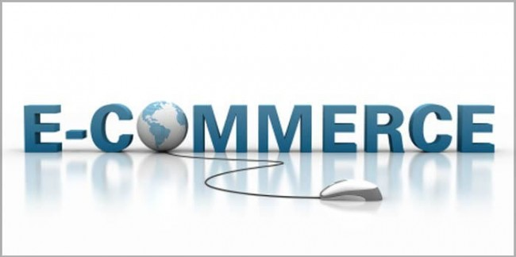
Project:-E- commerce Customer Segmentation and Prediction
Presented By :Gopal Baur

Slide 2
Agenda
Introduction
Necessary libraries import
Data Collection and Preprocessing
Exploratory Data Analysis (EDA)
Data Cleaning and Transformation
Feature Engineering
RFM Analysis: Theory and Process
RFM Analysis: Results/Visualization
Data scaling
Clustering Algorithms: Introduction
K-Means Clustering Explained
Hierarchical Clustering Explained
DBSCAN Clustering Explained
Analysis and Comparison of Models
Model Development Process
Model Performance & Evaluation
Customer Segments Analysis
Actionable Marketing Strategies
Conclusion and Recommendations

Slide 3
Introduction
Project Overview: A brief summary of the business problem, which is to segment e-commerce customers to enable targeted marketing and improve business strategy.
Objective: Define the specific goals, such as identifying distinct customer groups, understanding their behavior, and comparing the performance of different clustering models.
Customer Segmentation Benefits: Explain the value proposition, such as more efficient marketing and resource allocation

Slide 4
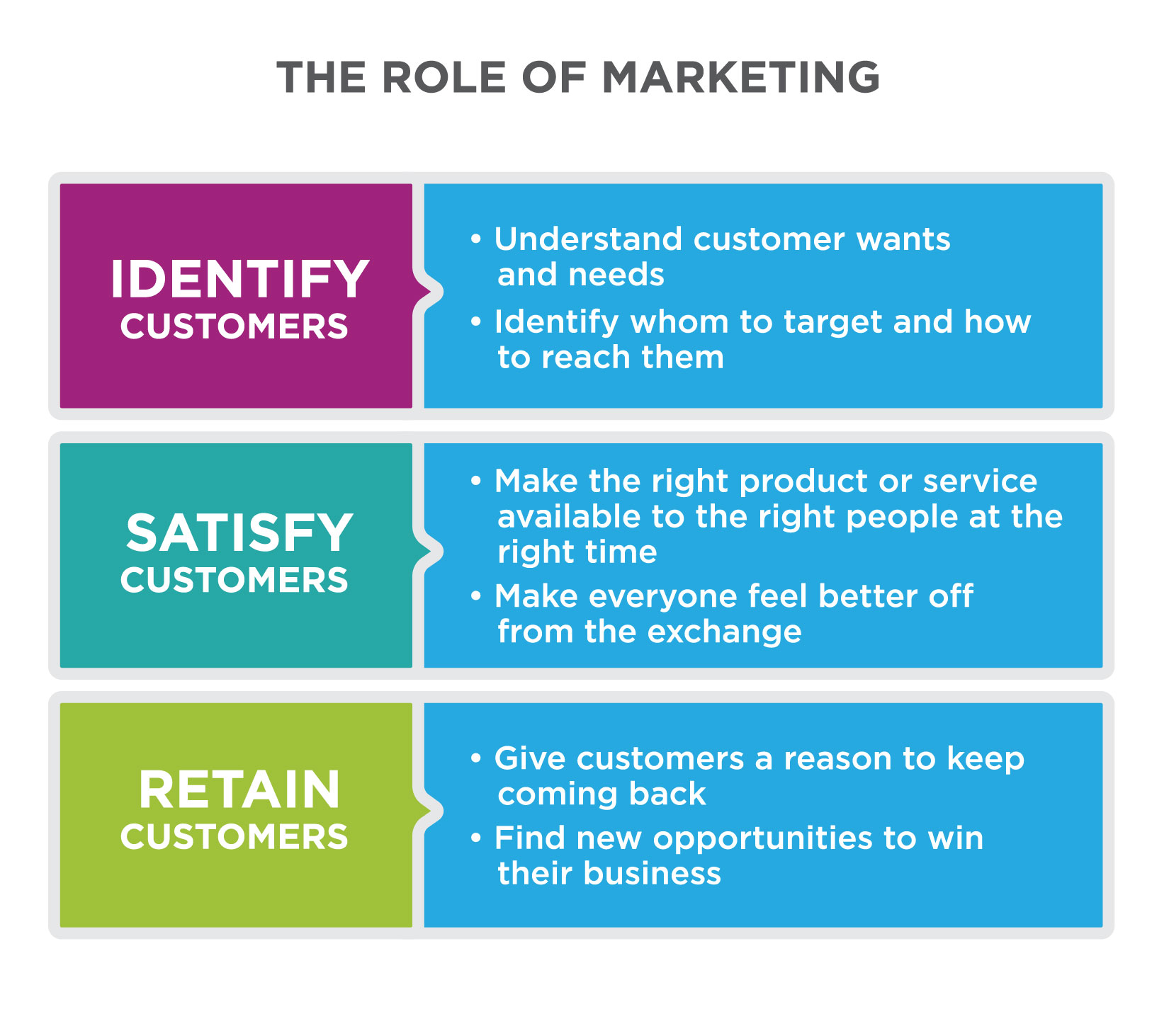
Project Overview:
This project aims to enhance marketing strategies and customer retention for an e-commerce company by gaining a deeper understanding of their customer base based on their purchasing patter. By leveraging machine learning, the project seeks to segment customers and predict future purchasing behavior. The goal is to develop a robust customer segmentation model and a predictive classifier to categorize customers based on their purchasing patterns, enabling the company to tailor marketing strategies, improve customer retention, and optimize inventory management.

Slide 5
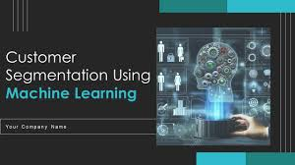
Objectives
Develop a robust customer segmentation model and a predictive classifier to categorize customers based on their purchasing patterns. This will enable the company to tailor marketing strategies, improve customer retention, and optimize inventory management.

Slide 6
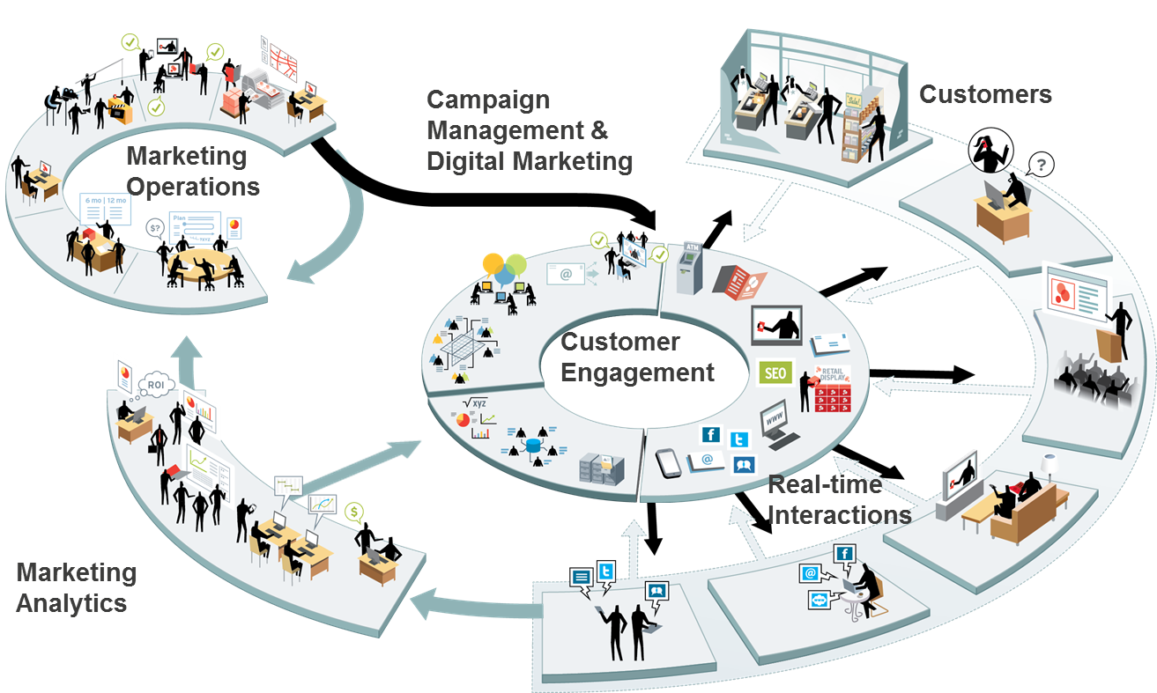
Project Benefits:
Enhanced Customer Segmentation: Identify and categorize customers based on purchasing behavior, allowing for targeted marketing strategies.
Cost Efficiency: Focus marketing efforts on high-value customer segments, optimizing resource allocation.
Improved Customer Satisfaction: Tailor offers and communication to specific customer needs, enhancing overall satisfaction.

Slide 7
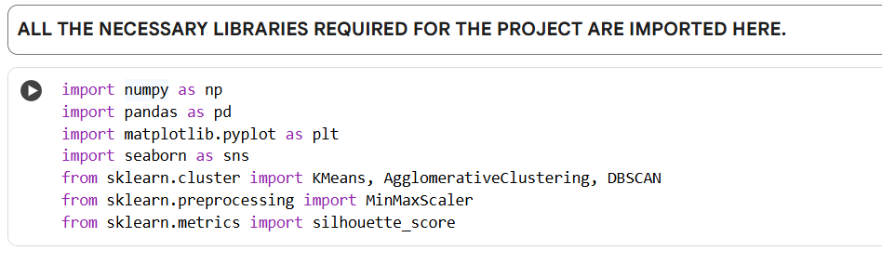
Necessary libraries import

Slide 8
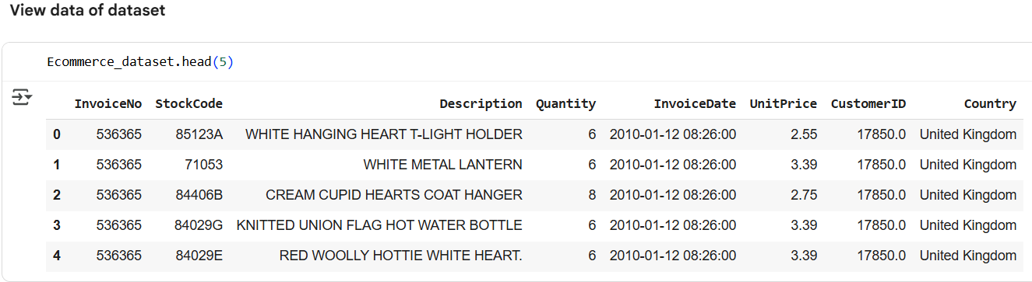
Data Collection and Preprocessing
Data Source: Identify the dataset used, such as online retail or e-commerce transaction data, including key features like InvoiceNo, CustomerID, UnitPrice, and Quantity.
Data Loading: The process of importing the dataset into the analysis environment.

Slide 9
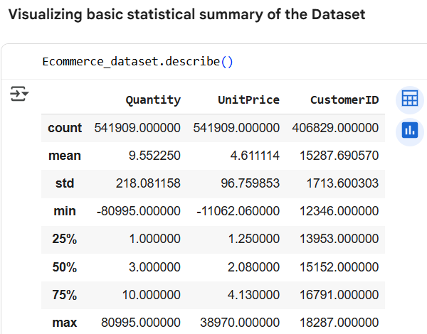
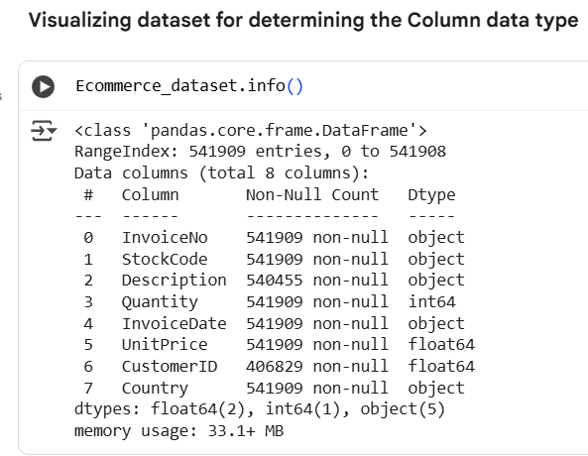
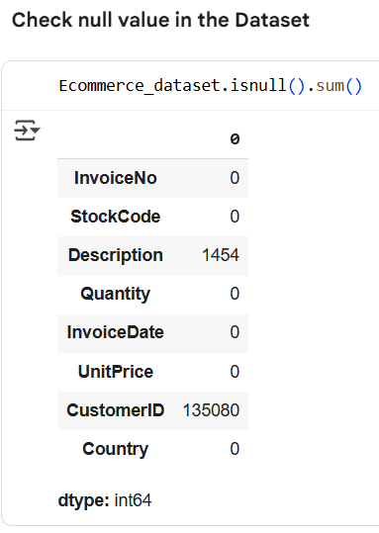
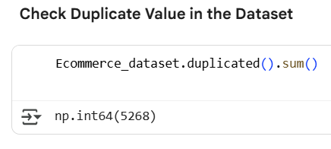
Exploratory Data Analysis (EDA): Initial analysis to understand the data's structure, identify missing values, and explore the distribution of key features.

Slide 10
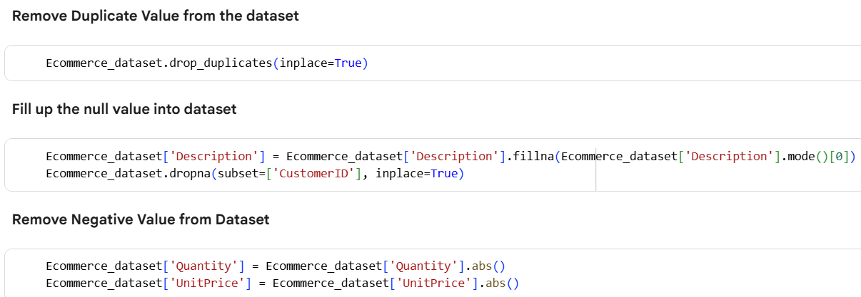
Data Cleaning and Transformation:
Handling missing data, particularly missing customer IDs.
Normalizing or scaling numerical features to ensure all models perform optimally.

Slide 11
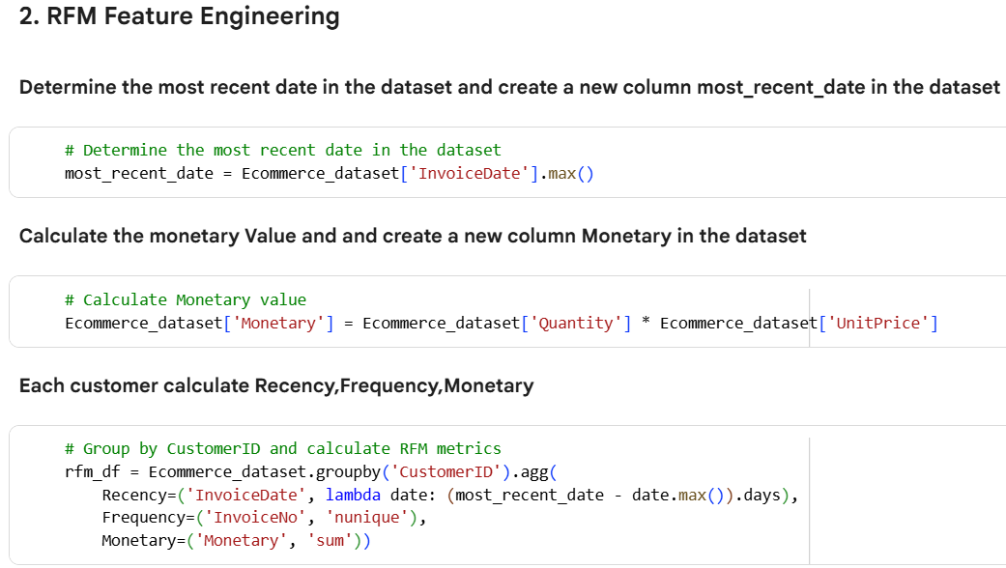
Feature Engineering: Creation of new, more informative features from existing data, such as Recency, Frequency, and Monetary (RFM) value.

Slide 12
Recency, Frequency, and Monetary (RFM) Analysis: Theory and Process:
Ecommerce_dataset.groupby('CustomerID').agg(...): This groups the dataset by unique CustomerID and then applies aggregation functions to calculate the RFM values for each customer.
Recency=('InvoiceDate', lambda date: (most_recent_date - date.max()).days): This calculates the Recency. For each customer, it finds the maximum InvoiceDate (their most recent purchase) and subtracts it from the most_recent_date (the latest date in the entire dataset). The .days extracts the difference in days.
Frequency=('InvoiceNo', 'nunique'): This calculates the Frequency. For each customer, it counts the number of unique InvoiceNo values, which represents the number of distinct orders they have placed.
Monetary=('Monetary', 'sum'): This calculates the Monetary value. For each customer, it sums the values in the 'Monetary' column (which you calculated earlier as Quantity * UnitPrice) to get the total amount spent by each customer.
The results of these aggregations are stored in a new DataFrame called rfm_df, with 'CustomerID' as the index and 'Recency', 'Frequency', and 'Monetary' as columns.

Slide 13
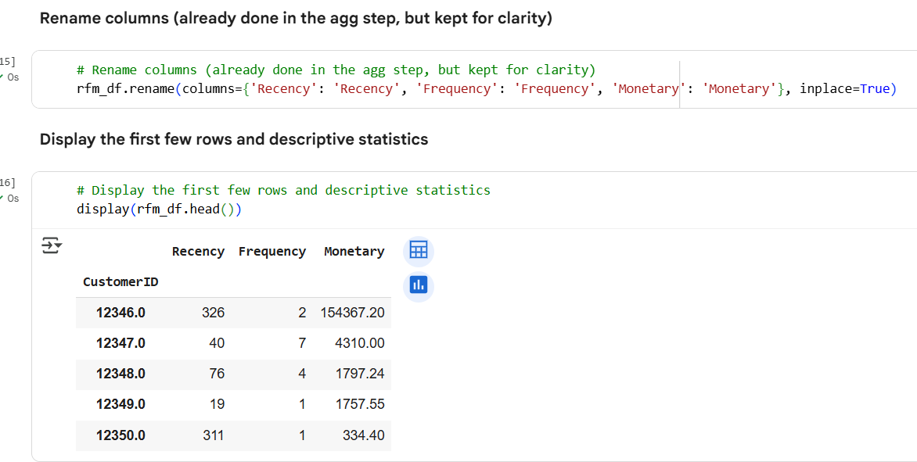
Recency, Frequency, and Monetary (RFM) Analysis: Results/Visualization

Slide 14
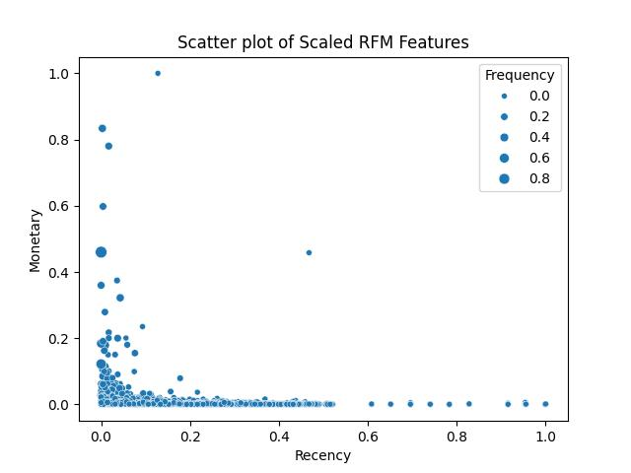
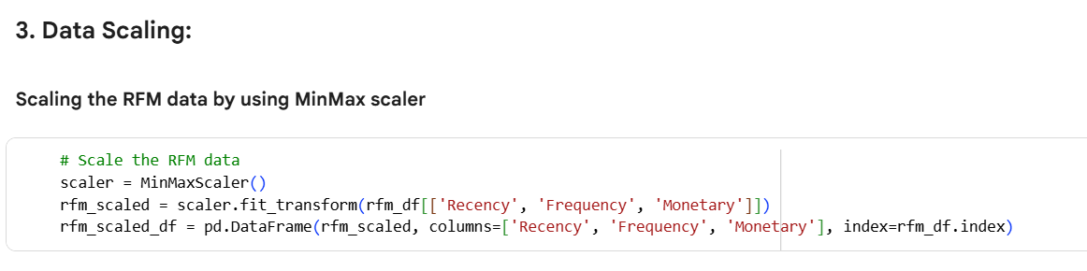
Data scaling
Data Scaling: The RFM features were scaled using MinMaxScaler to prepare them for clustering algorithms.

Slide 15
Clustering Algorithms: Introduction
Clustering is the process of organizing data into groups (clusters) where objects within each group are more similar to one another than to those in other groups. For example, if we have a dataset of animals, clustering can help us group them based on features like size, habitat, and diet. The idea is to find a structure within the data that allows for meaningful insights.
K-Means Clustering
Hierarchical Clustering (Agglomerative)
DBSCAN Clustering

Slide 16
K-Means Clustering Explained
Methodology: Explain how K-Means works, which is to partition data into K clusters based on the nearest mean.
Determining the Optimal K: Describe the use of the Elbow Method to find the most suitable number of clusters.
Implementation: Steps for applying the K-Means algorithm and fitting the model to the preprocessed data.
Resulting Clusters: Present the defined customer segments based on the K-Means output.

Slide 17
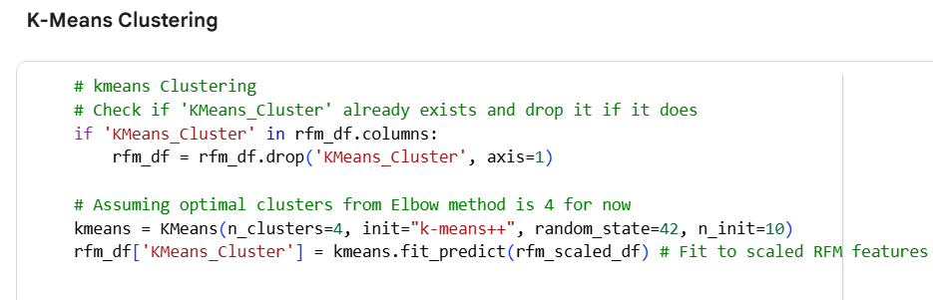
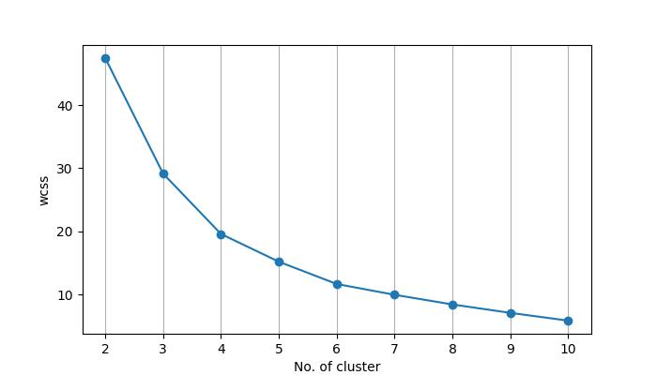
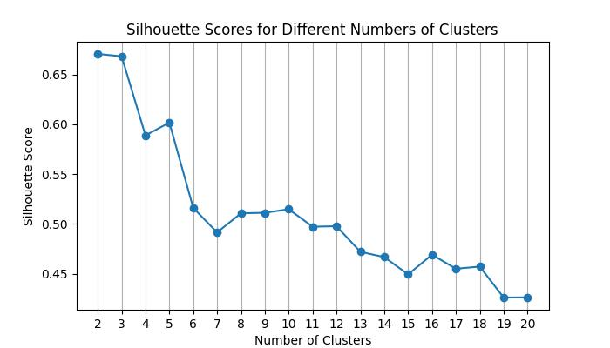
K-means Cluster Visualize:
Elbow Method Analysis

Slide 18
Hierarchical Clustering Explained
  Methodology: Explain the bottom-up approach of agglomerative clustering, which groups data points into a hierarchy of clusters.
  Dendrogram Analysis: Describe how to use a dendrogram to visualize the clustering process and select the optimal number of clusters.
  Implementation: Steps for applying the hierarchical clustering algorithm.
  Resulting Clusters: Present the customer segments from the hierarchical model.

Slide 19
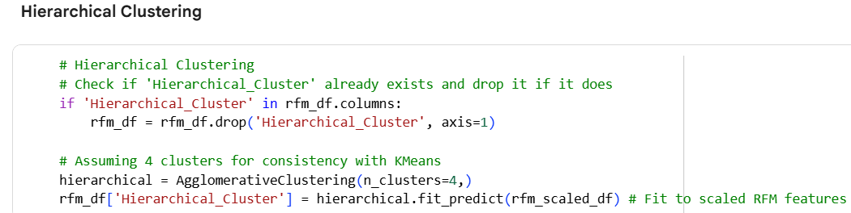
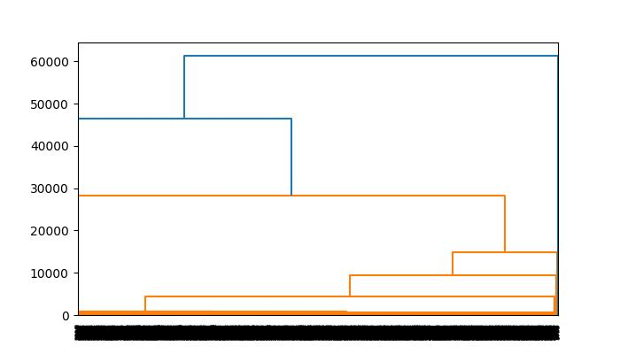
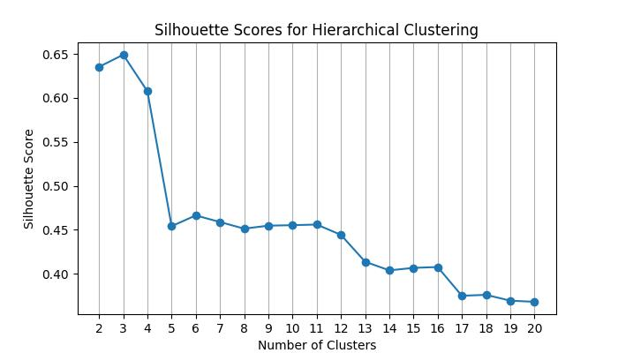
Hierarchical Clustering Visualizing
Dendrogram Method Analysis

Slide 20
Density-Based Spatial Clustering of Applications with Noise(DBSCAN) Clustering Explained
Methodology: Explain how DBSCAN identifies clusters based on data point density, effectively handling clusters of arbitrary shape and detecting outliers.
Parameter Selection: Discuss the importance of selecting the (epsilon) and minPts parameters.
Implementation: Steps for applying the DBSCAN algorithm.
Resulting Clusters: Present the discovered clusters and identify noise points.

Slide 21
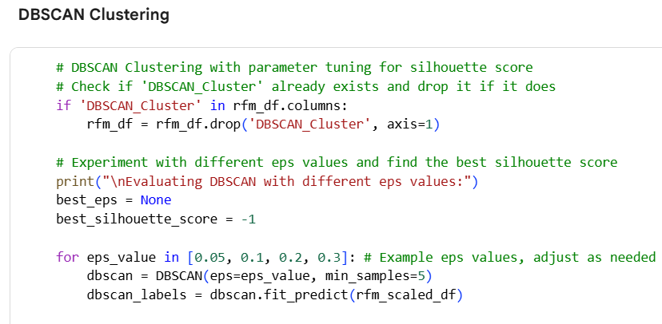
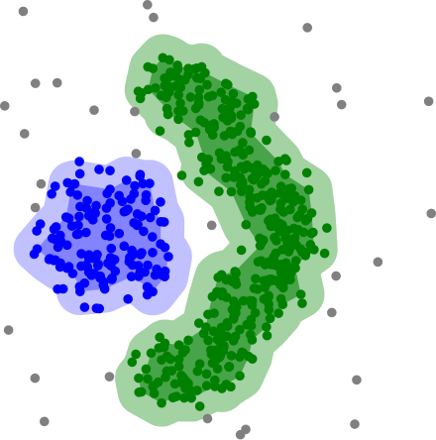
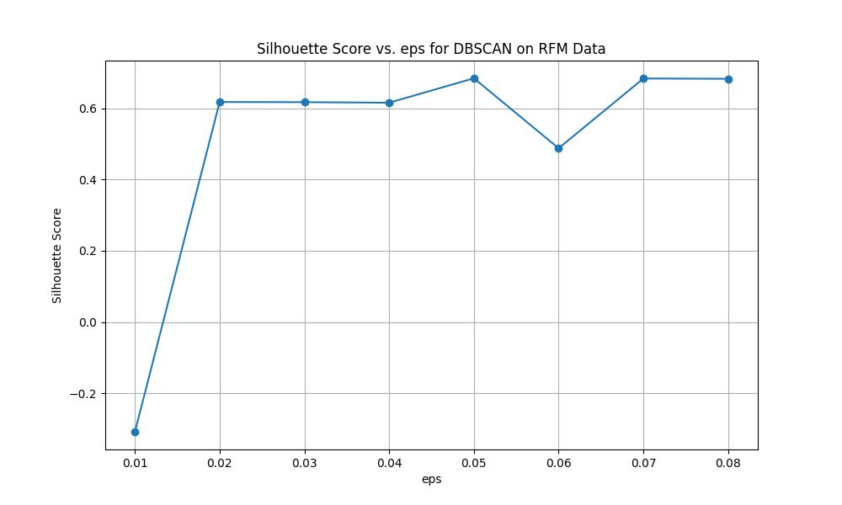
DBSCAN Clustering Visualizing
This Photo by Unknown Author is licensed under CC BY-SA

Slide 22
Analysis and Comparison of Models
Cluster Interpretation: Analyze and describe the characteristics of the customer segments found by each model. For example, a "High-Value" segment with high RFM scores.
Model Performance Comparison: Compare the different algorithms based on their strengths and weaknesses.
  K-Means is efficient but sensitive to the initial number of clusters.
  Hierarchical clustering provides a visual hierarchy but can be computationally expensive.
  DBSCAN handles arbitrary shapes and outliers well but can struggle with varying density.
Choosing the Best Model: Justify the selection of the most suitable clustering algorithm for this specific business problem.

Slide 23
Customer Segments Analysis
Summary of Clustering Results and Business Implications
Based on the silhouette scores and the characteristics of the clusters identified by each algorithm:
K-Means Clustering: Identified four distinct customer segments with varying levels of Recency, Frequency, and Monetary value. These segments are useful for targeted marketing campaigns, such as:
  High-Value Customers (Cluster 1): Reward programs, exclusive offers, and loyalty building initiatives.
  Lapsed/Low-Value Customers (Cluster 0): Re-engagement campaigns with special discounts or promotions.
  Churned/Inactive Customers (Cluster 2): Win-back strategies or analyzing reasons for churn.
  Occasional Customers (Cluster 3): Encouraging repeat purchases and increasing engagement.

Slide 24
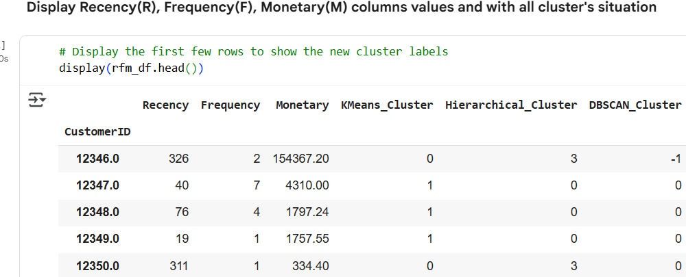
Hierarchical Clustering: Similar to K-Means, it also identified segments with comparable characteristics. The slightly higher silhouette score suggests that the boundaries between these segments might be a bit clearer. The business implications are similar to those of K-Means, allowing for targeted strategies based on the identified customer groups.
DBSCAN Clustering: This method identified a large core group of typical customers and successfully isolated a small number of outliers with extremely high frequency and monetary values.
  Core Group (Cluster 0): Represents the majority of customers and can be targeted with general marketing efforts and promotions.
  Outliers (Cluster -1): These could be valuable wholesale customers or very significant individual buyers. They might require personalized attention and tailored strategies rather than broad marketing campaigns.

Slide 25
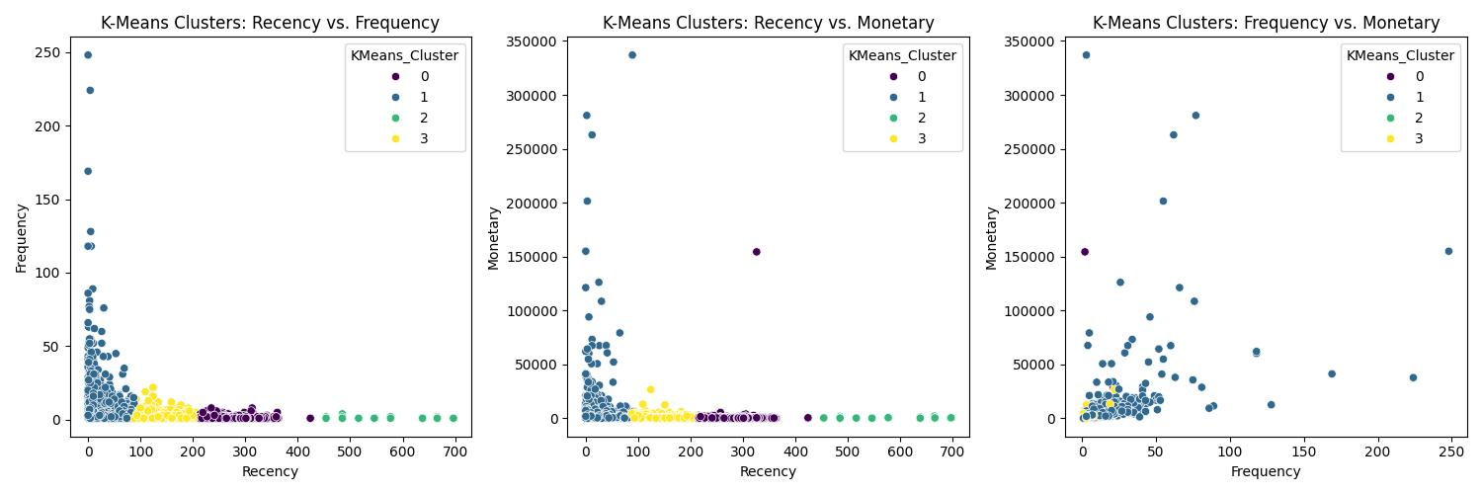
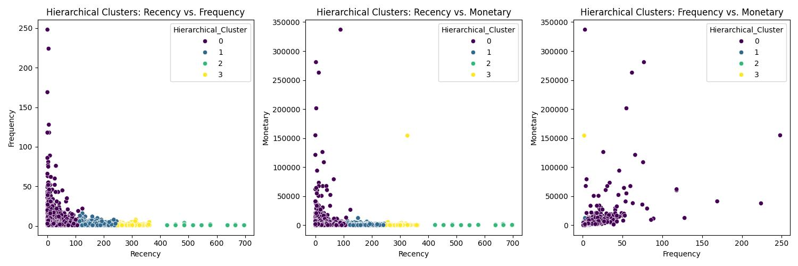
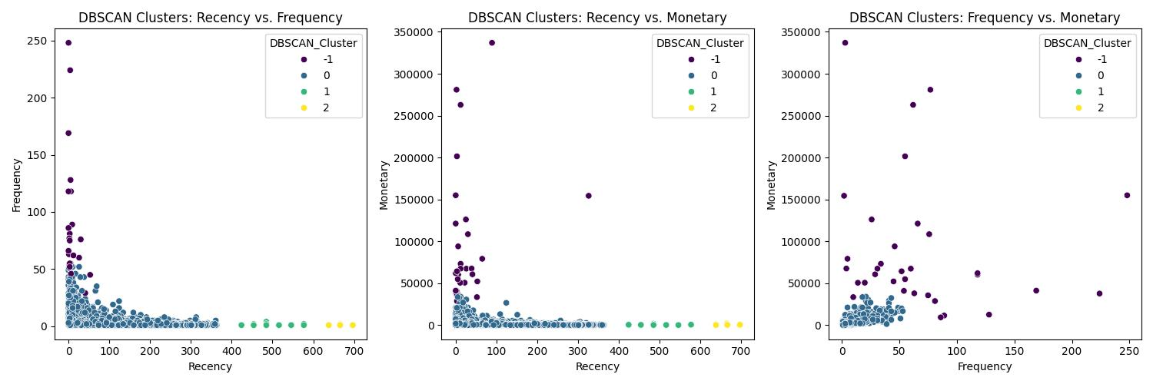
All cluster RFG’s ploting:

Slide 26
Actionable Marketing Strategies
Choosing the Best Clustering Method for Business Use:
While silhouette scores provide a quantitative measure of cluster separation, the "best" clustering method also depends on the specific business objective.
If the goal is to identify a fixed number of distinct customer groups for broad marketing campaigns, K-Means or Hierarchical Clustering with a chosen number of clusters (e.g., 4) are suitable. The similarity in cluster characteristics between these two methods suggests they capture similar underlying patterns in the data.
If the goal is to identify the main customer base and isolate extreme outliers for special handling, DBSCAN is a valuable choice. The outliers identified by DBSCAN might be crucial for understanding exceptional cases and preventing their influence on the analysis of typical customers.

Slide 27
In practice, it can be beneficial to explore the results of multiple clustering algorithms and choose the one that provides the most actionable and interpretable segments for the specific business needs. Further analysis of the characteristics of each cluster (beyond just the mean RFM values) can provide deeper insights into customer behavior within each segment.
These clusters represent customers who are likely not actively engaging with the business and may require specific strategies (like win-back campaigns) or further investigation into why they have become inactive.
Comparing the results, K-Means and Hierarchical Clustering with 4 clusters seem to identify similar types of segments (high-value, lapsed/low-value, inactive, and occasional). DBSCAN identifies a large core group and separates out extreme outliers. The choice of the "best" clustering depends on the specific business goal and which segmentation is most actionable. In practice, it can be beneficial to explore the results of multiple clustering algorithms and choose the one that provides the most actionable and interpretable segments for the specific business needs. Further analysis of the characteristics of each cluster (beyond just the mean RFM values) can provide deeper insights into customer behavior within each segment.

Slide 28
Conclusion and Recommendations
Key Findings: Summarize the most significant insights gleaned from the segmentation analysis.
Strategic Recommendations: Suggest actionable business strategies tailored to each customer segment, such as personalized marketing campaigns, loyalty programs, or inventory optimization.
Future Work: Outline potential next steps, such as integrating more data or deploying the model for real-time applications.

Slide 29
Thank You!

